Slide 1

International Business and Management
A Recommendation system
for travellers
based on tripadvisor.COM data
Nadezhda Denisova, Georgiy Trush
Academic advisor: E. A. Antipov, Associate Professor
Saint Petersburg 2020

Slide 2

International Business and Management
Presentation OUTLINE
Introduction
Term Definition
Research Gap
Research Questions
Methodology
Description of the Results
Conclusions

Slide 3
International Business and Management
introduction
Consumers are confused by large selections of products, unless they already know what to choose.
Problem of choice overload is especially concerning to online businesses that offer overwhelming varieties of products, services or content.
Recommendation systems are software tools that identify preferences of users in order to provide them with the most relevant options.
Recommendation systems are major drivers behind the global success of Netflix and Amazon.
(Gao & Simonson, 2016; Gómez-Uribe & Hunt, 2015; Sharma & Singh, 2016; Smith & Linden, 2017)

Slide 4



International Business and Management
introduction
Recommendation systems in the tourism industry
Trip bookings
Travel routes
Points of interest
(Menk et al., 2019)

Slide 5


International Business and Management
introduction
Research
Proposition
Recommendation system
based on TripAdvisor data of Points of interest
Benefits for travel businesses:
The largest database of travel reviews;
More than 1.2 million attractions;
Only employs ranking algorithms.
Targeted advertising on TripAdvisor;
Opportunity for travel agencies to develop unique client-specific tours.
(TripAdvisor, 2019)

Slide 6


International Business and Management
introduction
Research objectives
Research contribution
Business value
Test and compare state-of-the-art models on the TripAdvisor data to develop a novel recommendation system in tourism domain;
Launch an online recommendation service that provides travellers with personalised suggestions of places to visit.

Slide 7
International Business and Management
Term definition
“Recommender system” – a web-based application that employs a machine learning model to predict which new items a given user will prefer the most, based on the accumulated data (i.e. user ratings for items).
“Cold start” – a problem that consists in having too little information about a new user to provide him with a relevant recommendation.
(Adomavicius & Tuzhilin, 2005; Lu et al., 2012)

Slide 8


International Business and Management
TERM DEFINITION
Types of recommender system approaches
 | Collaborative filtering | Content-based filtering | Hybrid
Description | User similarity | Item similarity | Combination of the other two
High accuracy
Cold start
(Khusro et al., 2016)

Slide 9
International Business and Management
Research gap
The 5 most common directions for future recommender system research:
Consider less explored application domains;
Develop a hybrid filtering recommender system;
??
??
??
(Alyari & Navimipour, 2018)

Slide 10
International Business and Management
Research gap
Distribution of hybrid system studies across application domains
(Cano & Morisio, 2017)

Slide 11
International Business and Management
Research gap
The 5 most common directions for future recommender system research:
Consider less explored application domains;
Develop a hybrid filtering recommender system;
??
??
??
Hybrid filtering system in the tourism domain
3. Compile datasets of previously untested data;
(Alyari & Navimipour, 2018)

Slide 12
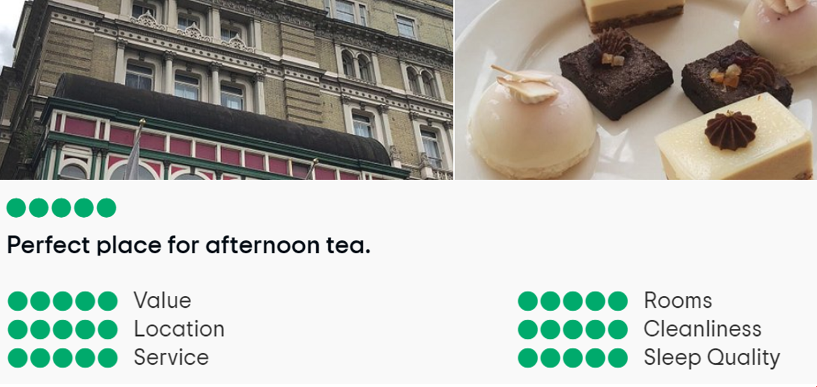
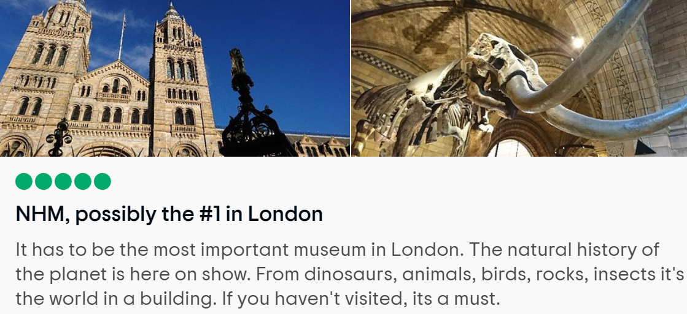
International Business and Management
Research gap
Previous TripAdvisor studies User reviews for hotels and restaurants (overall and multi-criteria ratings)
Untested TripAdvisor data User reviews for tourist attractions (overall ratings and textual reviews)
(Ahani et al., 2019; Jannach et al., 2014; Fuchs et al., 2012)

Slide 13
International Business and Management
Research gap
The 5 most common directions for future recommender system research:
Consider less explored application domains;
Develop a hybrid filtering recommender system;
Compile datasets of previously untested data;
??
??
Hybrid filtering system in the tourism domain
TripAdvisor reviews on attractions
4. Adopt new models from other domains;
5. Apply semantic analysis techniques.
Most efficient models for sparse datasets – latent factor models
(Alyari & Navimipour, 2018)

Slide 14



International Business and Management
Research gap
Hybrid system structure
Collaborative filtering
Content-based filtering
Film domain
e-Documents domain
Matrix factorization models
used for rating prediction
Latent Dirichlet Allocation
used for topic extraction
(Chenguang & Wenxin, 2010; Koren et al., 2009)

Slide 15
International Business and Management
Research questions
Research question №1
Which matrix factorisation model produces the most accurate recommendations based on the ratings for tourist attractions?
Hypothesis №1
The FunkSVD model will produce the best results in the accuracy metric of MAE, compared to other matrix factorisation models of SVD++ and NMF as well as to the common benchmark methods of user- and item-based k-Nearest Neighbours.
(Cacheda et al., 2011)

Slide 16
International Business and Management
Research questions
Research question №2
Does the LDA model reveal coherent categories of user preferences based on the reviews for tourist attractions?
Hypothesis №2
The LDA model will reveal a more concise range of attraction types as enjoyed by travellers, in comparison to the 15 default types specified on the TripAdvisor platform.

Slide 17
International Business and Management
METHODOLOGY
Data focus
In 2019, 53% of all attraction reviews on TripAdvisor were posted under European attractions;
The single most visited European city in 2019 – London, UK.
Rank | Destination city | Overnight visitors (MM) in 2019
1 | Bangkok | 23.54
2 | London | 19.75
3 | Paris | 19.52
(Mastercard Inc., 2019)

Slide 18
International Business and Management
METHODOLOGY
Data collection
Web-scraping tools – Python libraries of requests and BeautifulSoup;
Data sample – an average of 150 user reviews per each of 975 attractions (42% of London attractions);
Representativeness – ensured by collecting every review posted over the past year (Jan. 2019 – Dec. 2019);
Two datasets – user-item matrices with numerical ratings and with textual reviews (data sparsity – 99.84%).
(Vargiu & Urru, 2013)

Slide 19
International Business and Management
METHODOLOGY
Matrix Factorisation techniques
Matrix Factorisation techniques consist in splitting the user-item matrix into the vectors of user factors and item factors, which are then used to infer the rating patterns for every user.
Hyperparameters:
Number of factors;
Learning rate;
Regularisation.
Trained values:
User factors;
Item factors;
User bias;
Item bias.
(Koren et al., 2009)

Slide 20
International Business and Management
METHODOLOGY
Matrix Factorisation models
 | FunkSVD | SVD++ | NMF
Optimisation | Stochastic Gradient Descent (SGD)
Regularisation
Implicit ratings
Non-negative values
Python library: Surprise (Simple Python Recommendation System Engine).
(Cacheda et al., 2011; Koren, 2008; Koren et al., 2009)

Slide 21
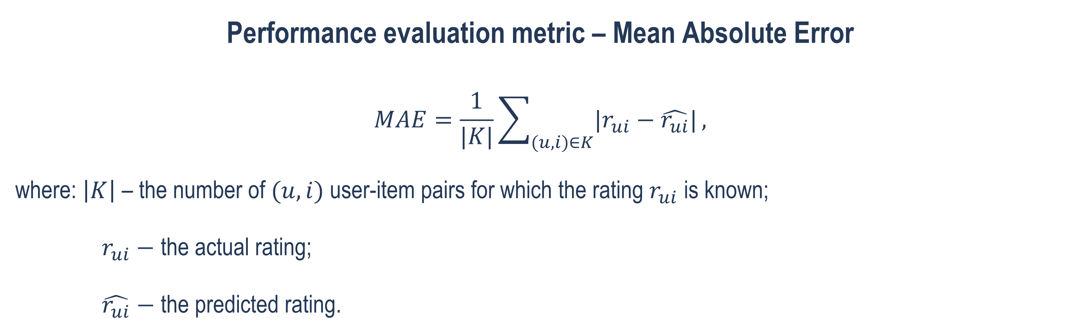
International Business and Management
METHODOLOGY
Performance evaluation metric – Mean Absolute Error
$$MAE=\frac{1}{|K|}\sum_{(u,i)∈K}{|r_{ui}−\hat{r_{ui}}|},$$
where: $\left|K\right| \text{–} \text{the} \text{number} \text{of} (u,i)$user-item pairs for which the rating $r_{ui}$ is known;
$r_{ui}−$ the actual rating;
$\hat{r_{ui}}$ $−$ the predicted rating.
(Hernández del Olmo & Gaudioso, 2008)

Slide 22
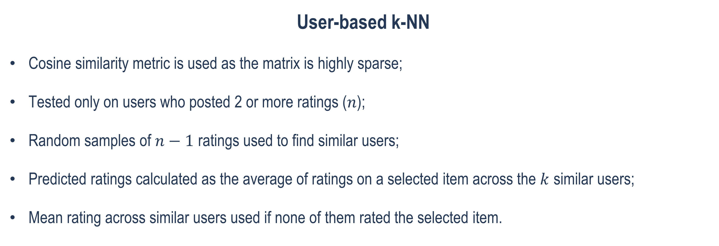
International Business and Management
METHODOLOGY
User-based k-NN
Cosine similarity metric is used as the matrix is highly sparse;
Tested only on users who posted 2 or more ratings ($n$);
Random samples of $n−1$ ratings used to find similar users;
Predicted ratings calculated as the average of ratings on a selected item across the $k$ similar users;
Mean rating across similar users used if none of them rated the selected item.
(Cacheda et al., 2011)

Slide 23
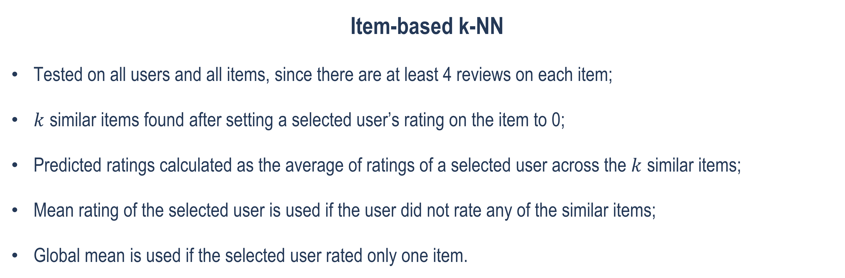
International Business and Management
METHODOLOGY
Item-based k-NN
Tested on all users and all items, since there are at least 4 reviews on each item;
$k$ similar items found after setting a selected user’s rating on the item to 0;
Predicted ratings calculated as the average of ratings of a selected user across the $k$ similar items;
Mean rating of the selected user is used if the user did not rate any of the similar items;
Global mean is used if the selected user rated only one item.
(Cacheda et al., 2011)

Slide 24
International Business and Management
METHODOLOGY
The LDA algorithm
Python libraries: nltk – for preprocessing, genism – for the LDA model construction;
Reviews on each attraction concatenated into one text (i.e. document), 975 documents in total;
Preprocessing: elimination of stop-words, lemmatisation, elimination of lemmas used in less than 10 documents, representing each document as a bag of words (BoW);
Coherence scores (CS) used to reveal the optimal number of topics.
(Guo et al., 2016; Röder et al.,2015)

Slide 25
International Business and Management
Description of the results
Matrix Factorisation Algorithms
 | FunkSVD | SVD++ | NMF
MAE | 0.688 | 0.699 | 0.862
Factors | 7 | 3 | 2
Learning rate | 0.001 | 0.001 | 0.005
Regularisation | 0.005 | 0.005 | 0.06 for users & items 0.02 for biases

Slide 26
International Business and Management
Description of the results
User-based k-NN
Base sample | Number of users | Fraction of users | MAE
2 | 8807 | 18% | 0.725
3 | 3910 | 8% | 0.730
4 | 2256 | 4.7% | 0.692

Slide 27
International Business and Management
Description of the results
FunkSVD and k-NN
 | FunkSVD | User-based k-NN | Item-based k-NN
MAE | 0.688 | 0.692 | 0.699
FunkSVD showed the best MAE performance in comparison to SVD++ and NMF as well as the user- and item-based k-NN.
Thus, H1 is confirmed.

Slide 28
International Business and Management
Description of the results
Top 3 Coherence scores
Number of topics | Score
16 | 0.535
17 | 0.531
6 | 0.519

Slide 29
International Business and Management
Description of the results
LDA 6-topic model output
 | TOPIC 1 | TOPIC 2 | TOPIC 3 | TOPIC 4 | TOPIC 5 | TOPIC 6
Title | Landmarks | Exhibitions | City Tours | Food | Nature | Performing Arts
Top Words | church square statue memorial palace | museum exhibit tour galleries art | tour bridge guide Thames tower | market restaurant stall eat bar | garden cafe animals children kid | theatre seat play perform venue
LDA revealed a more concise number of 6 categories with the coherence loss of only 0.015.
Thus, H2 is confirmed.

Slide 30
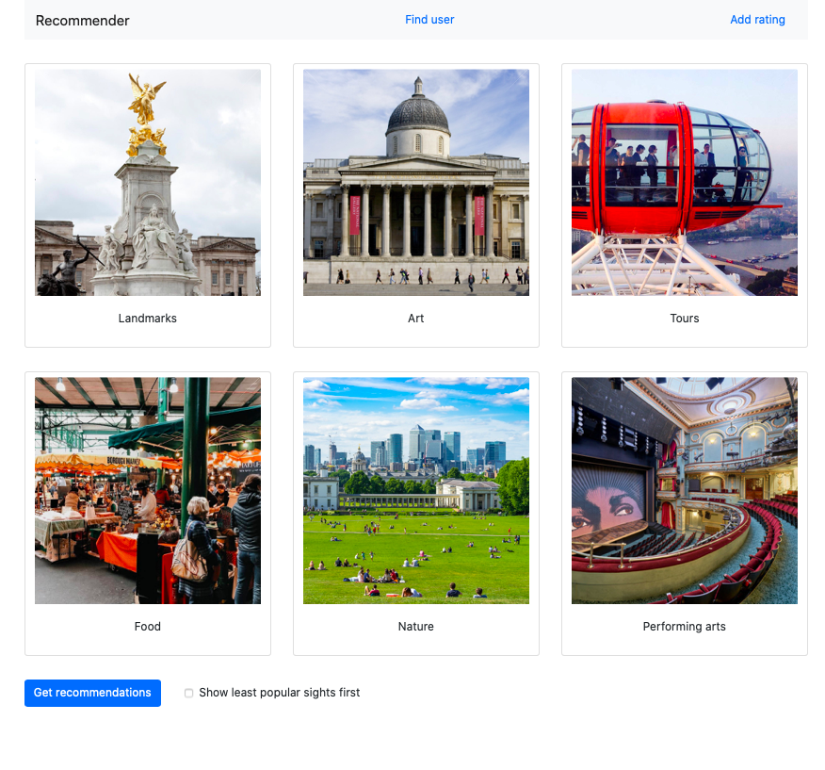
International Business and Management

Slide 31
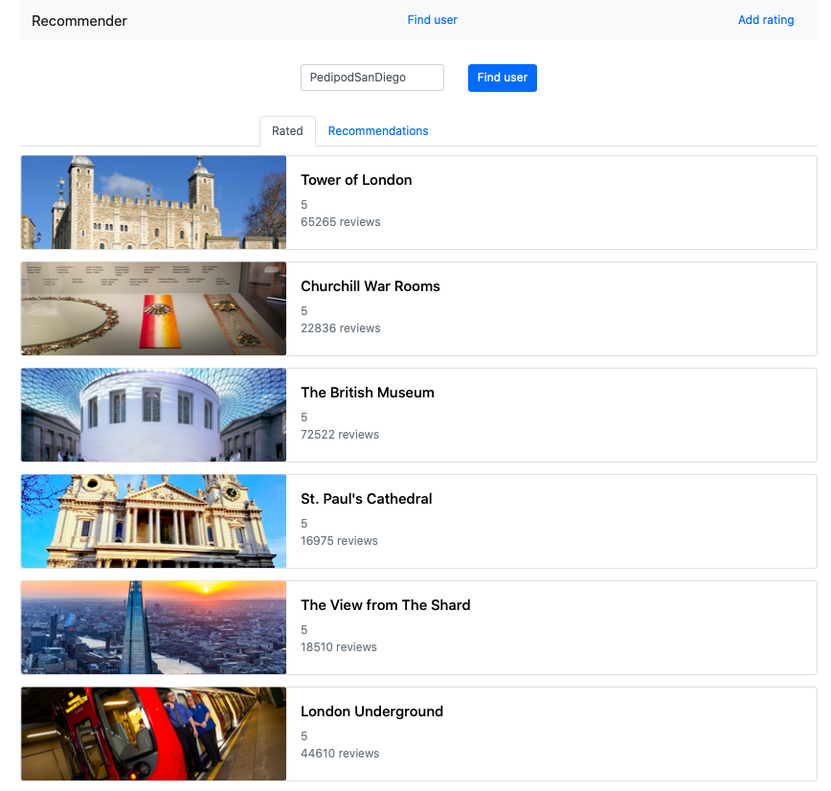
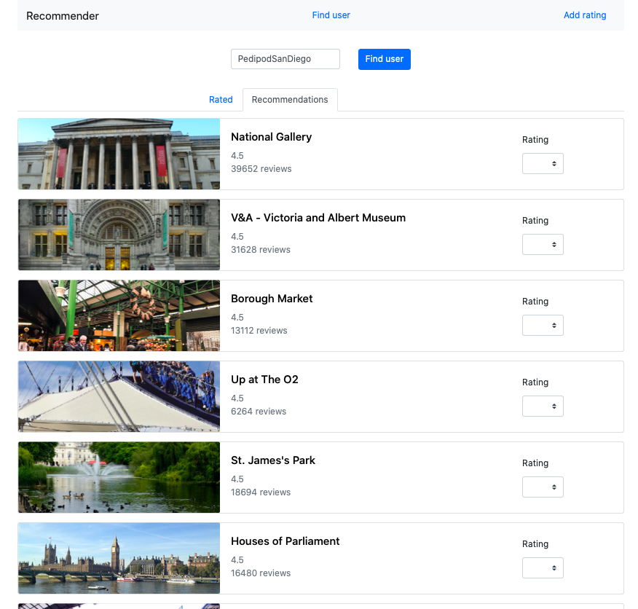
International Business and Management

Slide 32
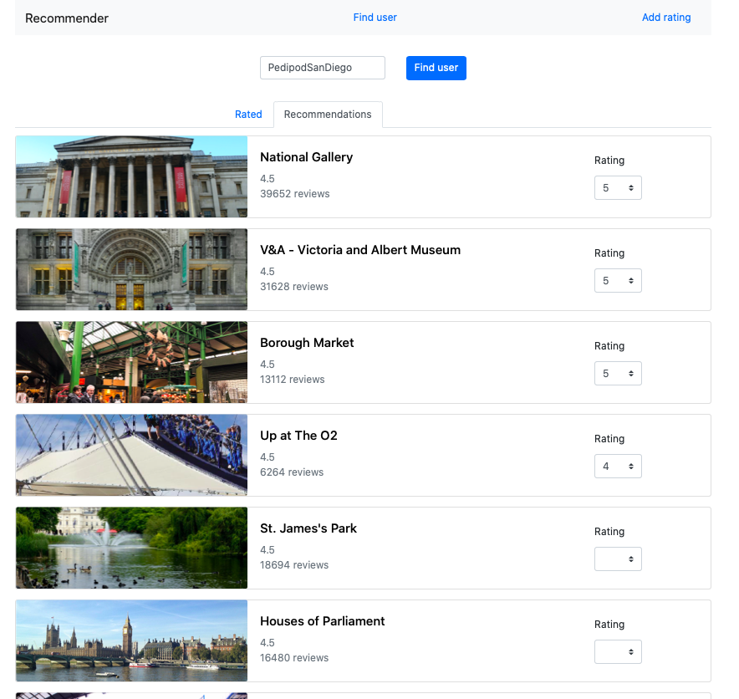
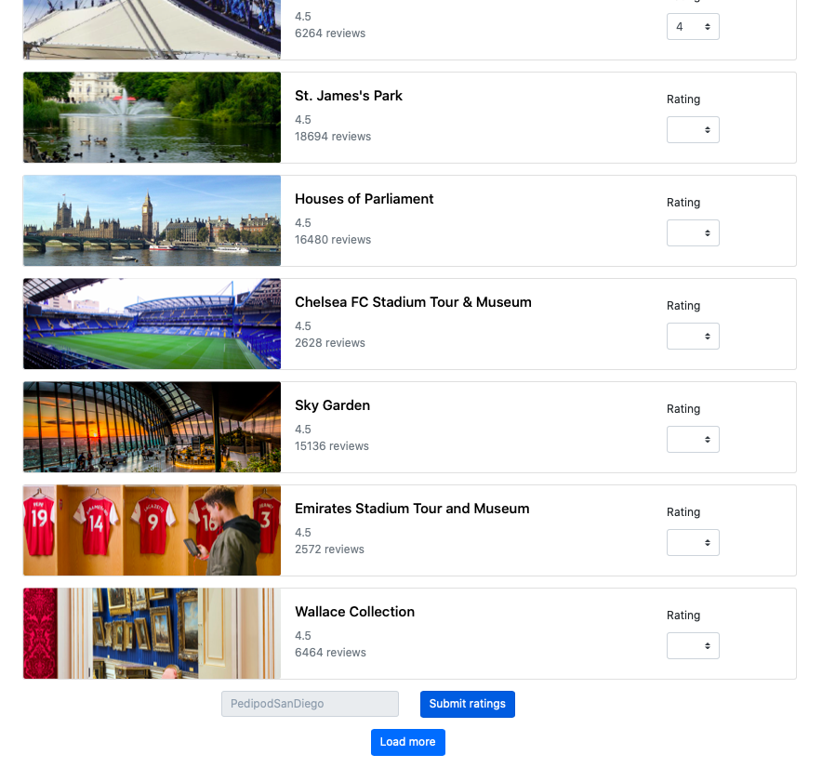
International Business and Management

Slide 33
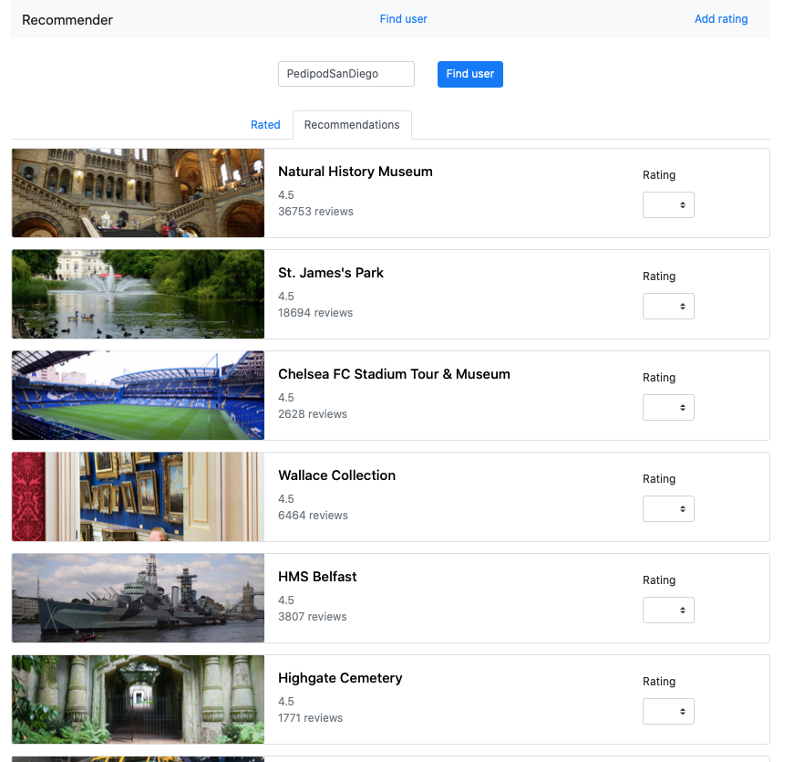
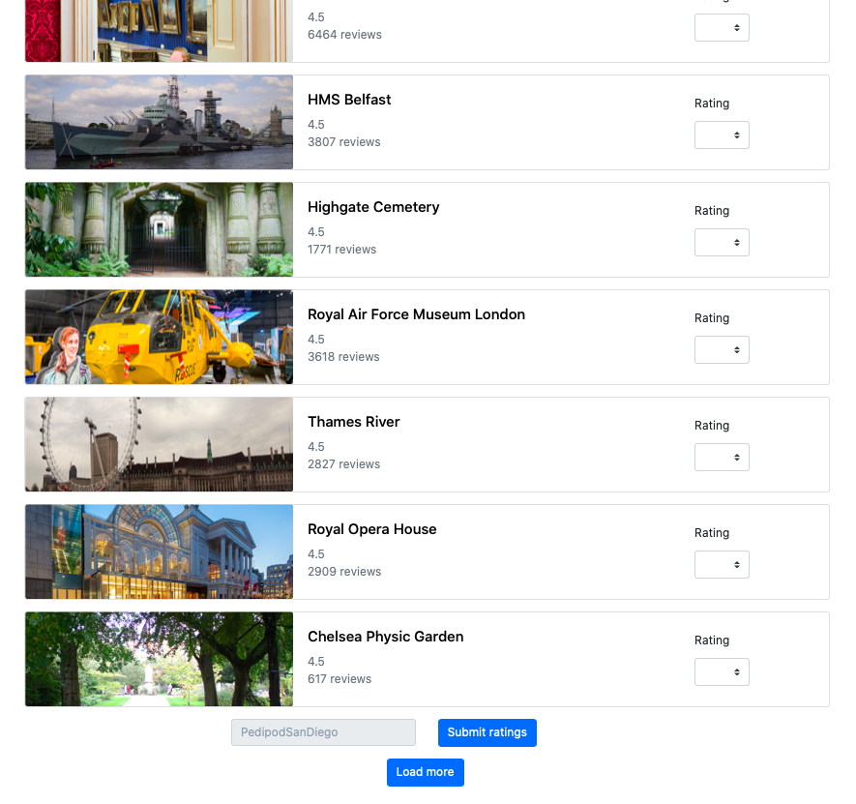
International Business and Management

Slide 34
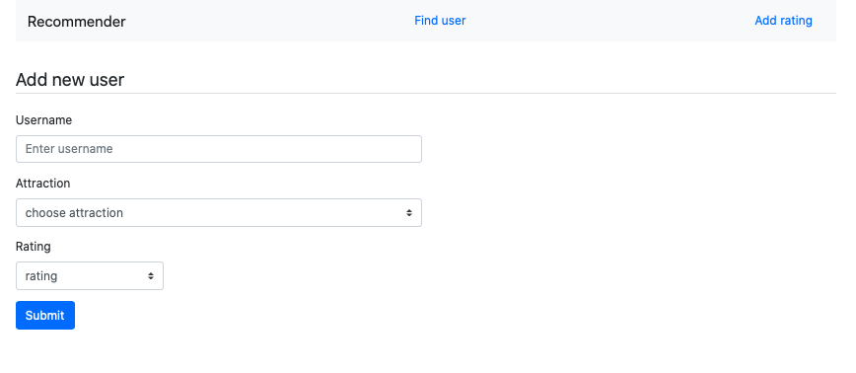
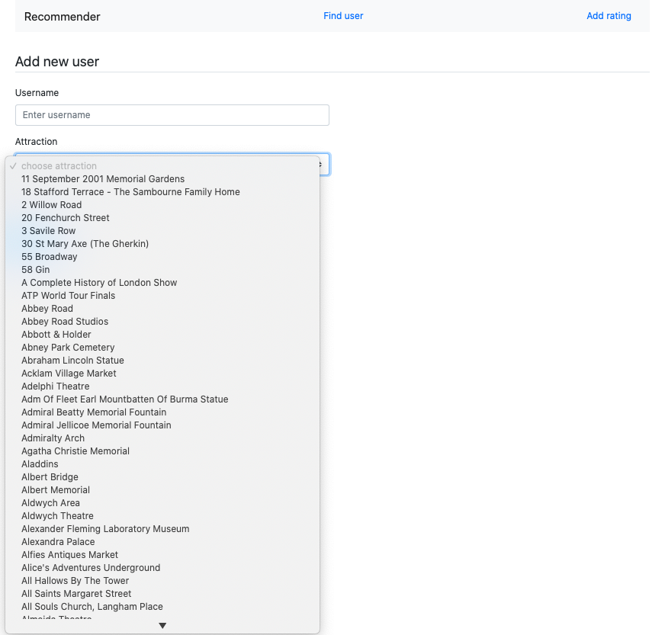
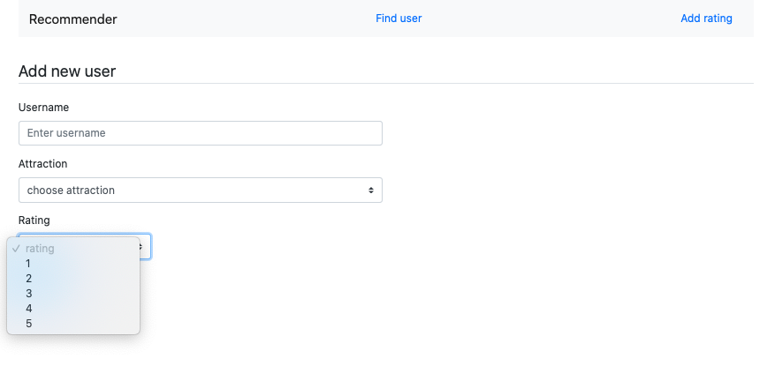
International Business and Management

Slide 35
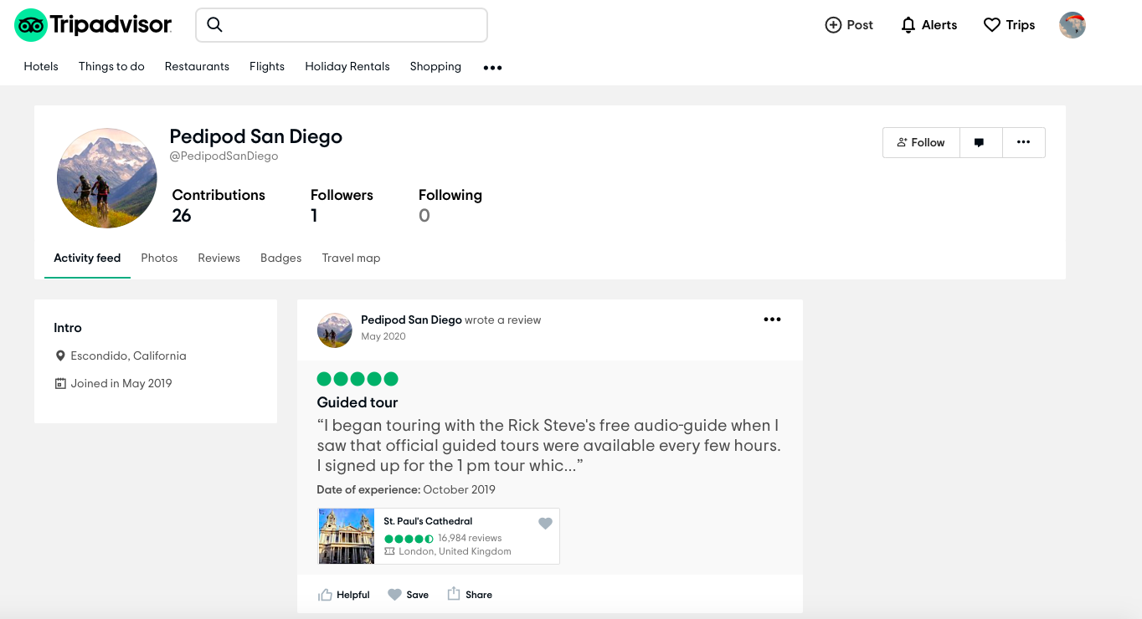



International Business and Management
Recommendations
Recommendations

Slide 36

International Business and Management
Description of the results
Scan QR-code to view the GitHub repository with the source code

Slide 37
International Business and Management
Conclusions
Suggestions for future research:
Increase not so much the dataset size as the density of the user-item matrix, for instance, by scraping the reviews of the most prolific users via the TripAdvisor API;
Test more a hybridized combination of collaborative filtering algorithms for potential improvement of results;
Evaluate algorithms not only on accuracy of rating predictions, but also on relevance of recommendations;
Extend the functionality to optimally map a potential tour across the city of London, based on the user’s recommendation list of tourist landmarks.

Slide 38
International Business and Management
main References
Adomavicius, G., & Tuzhilin, A. (2005). Toward the next generation of recommender systems: a survey of the state-of- the-art and possible extensions. IEEE Transactions on Knowledge and Data Engineering, 17(6), 734-749. doi: 10.1109/TKDE.2005.99
Alyari, F., & Navimipour, N. (2018). Recommender systems: A systematic review of the state-of-the-art literature and suggestions for future research. Kybernetes, 47(5), 985-1017. doi: 10.1108/K-06-2017-0196
Cacheda, F., Carneiro, V., Fernández, D., & Formoso, V. (2011). Comparison of collaborative filtering algorithms: Limitations of current techniques and proposals for scalable, high-performance recommender systems. ACM Transactions on the Web, 5(1), 1-33. doi: 10.1145/1921591.1921593
Çano, E., & Morisio, M. (2017). Hybrid Recommender Systems: A Systematic Literature Review. Intelligent Data Analysis, 21(5), 1487-1524. doi: 10.3233/IDA- 163209
Herlocker, J., Konstan, J., Terveen, L., & Riedl, J. (2004). Evaluating collaborative filtering recommender systems. ACM Transactions on Information Systems, 22(1), 5-53. doi: 10.1145/963770.963772
Jelodar, H., Wang, Y., & Yuan, C. (2019). Latent Dirichlet allocation (LDA) and topic modeling: models, applications, a survey. Multimedia Tools and Applications, 78, 15169–15211. doi: 10.1007/s11042-018-6894-4
Koren, Y., Bell, R., & Volinsky, C. (2009). Matrix Factorization Techniques for Recommender Systems. Computer, 42(8), 30-37. doi: 10.1109/MC.2009.263

Slide 39

International Business and Management
Other References
Scan QR-code to view all references

Slide 40
ndenisova@edu.hse.ru
gdtrush@edu.hse.ru

